Slide 1
Virtual Machine Overview
A Virtual Machine (VM) is a software-based simulation of a physical computer.
It runs an entire operating system (OS) and applications—just like a real computer—but inside a window on your current machine.
In Simple Terms A Virtual Machine is like a computer inside your computer.
You can run Windows inside Linux, or Linux inside Windows, without needing a separate physical device.
Components of a Virtual Machine
Guest OS: The operating system installed inside the VM (e.g., Ubuntu, Windows).
Hypervisor: Software that creates and runs VMs (e.g., VMware, VirtualBox, Hyper-V).
Virtual Hardware: Simulated CPU, RAM, disk, network, etc., assigned from the host system.

Slide 2
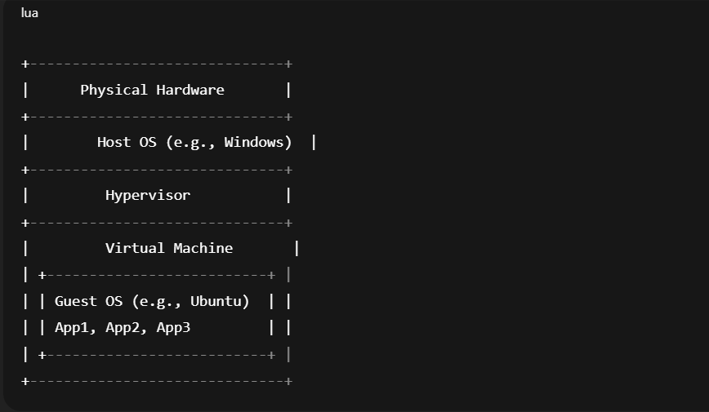
Virtual Machine Architecture Diagram
🏗️ Architecture Diagram

Slide 3
Virtual Machine Key Features
Feature | Description
Isolation | VMs are completely isolated from each other
Multi-OS support | Run different operating systems simultaneously
Snapshots | Save the state of the VM and roll back anytime
Portability | VMs can be exported and moved across machines
Security | Strong separation from host and other VMs

Slide 4
Virtual Machine Use Cases
Testing apps in multiple OS environments
Running legacy applications
Learning operating systems
Creating isolated environments for development or malware analysis
Hosting multiple servers on one physical machine
🎯 Real-World Analogy
A Virtual Machine is like a guest house inside your main house:
It has its own rooms (RAM, disk).
It runs independently.
You can shut it down without affecting your main house.

